Slide 1
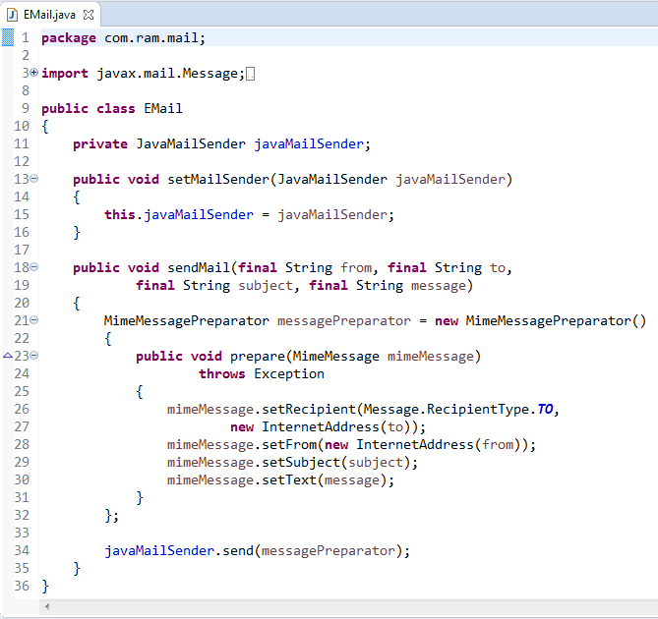
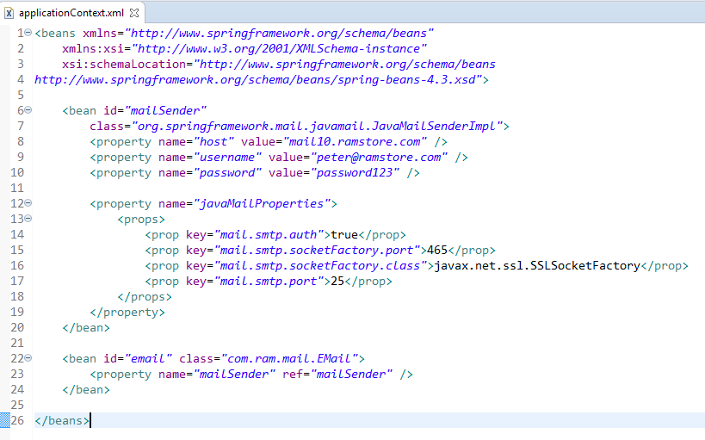
Example of Sending mail in Spring by Email Server provided by host Provider
If you have your own site, you can use your mail server.

Slide 2
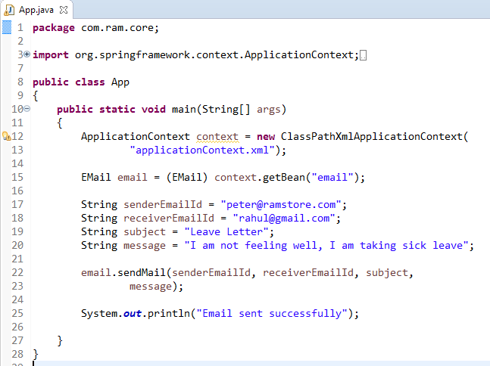
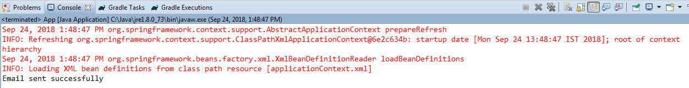
Example of Sending mail in Spring by Email Server provided by host Provider

